Slide 1


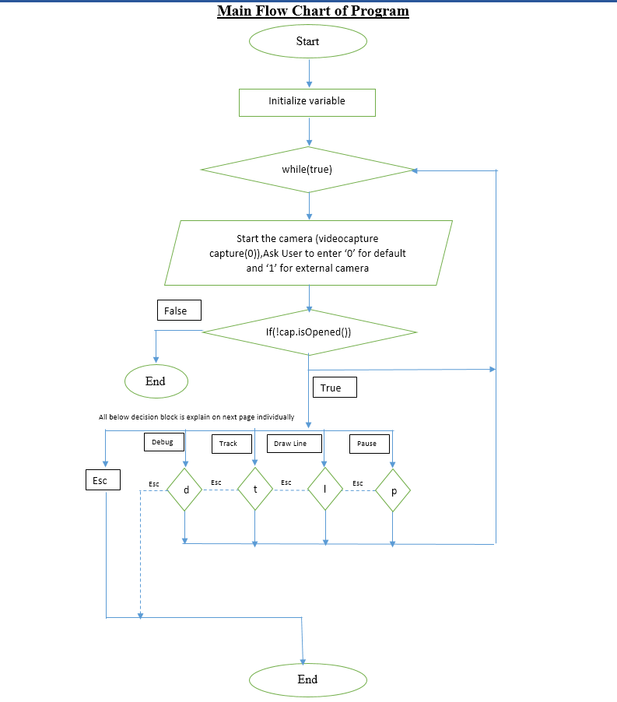
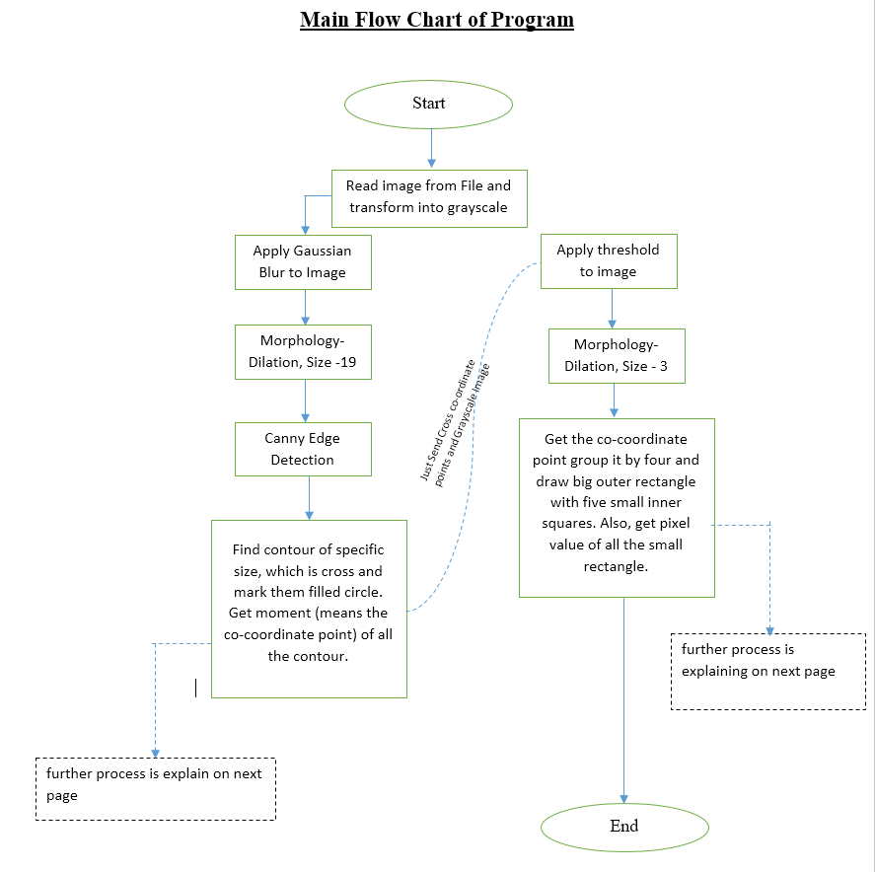
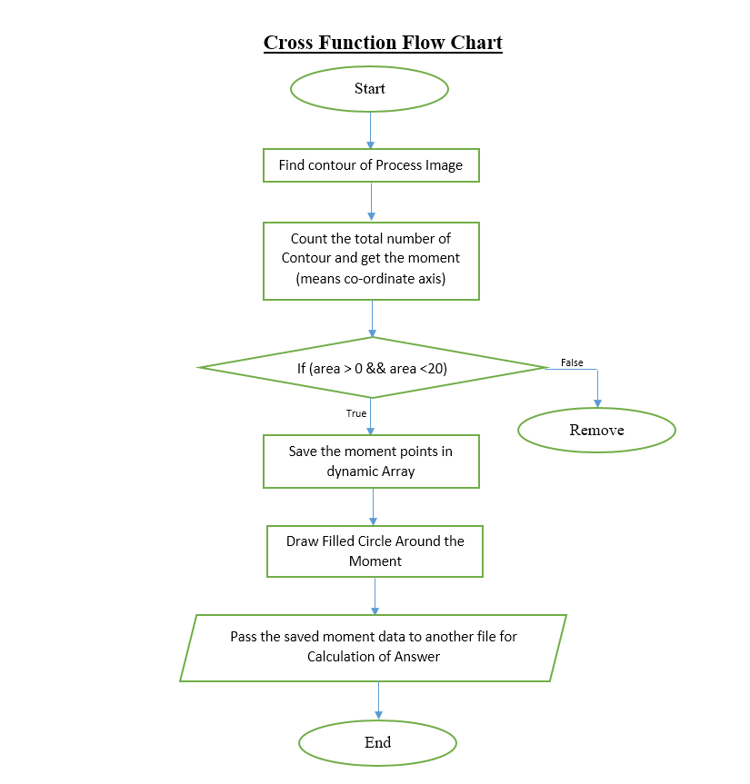
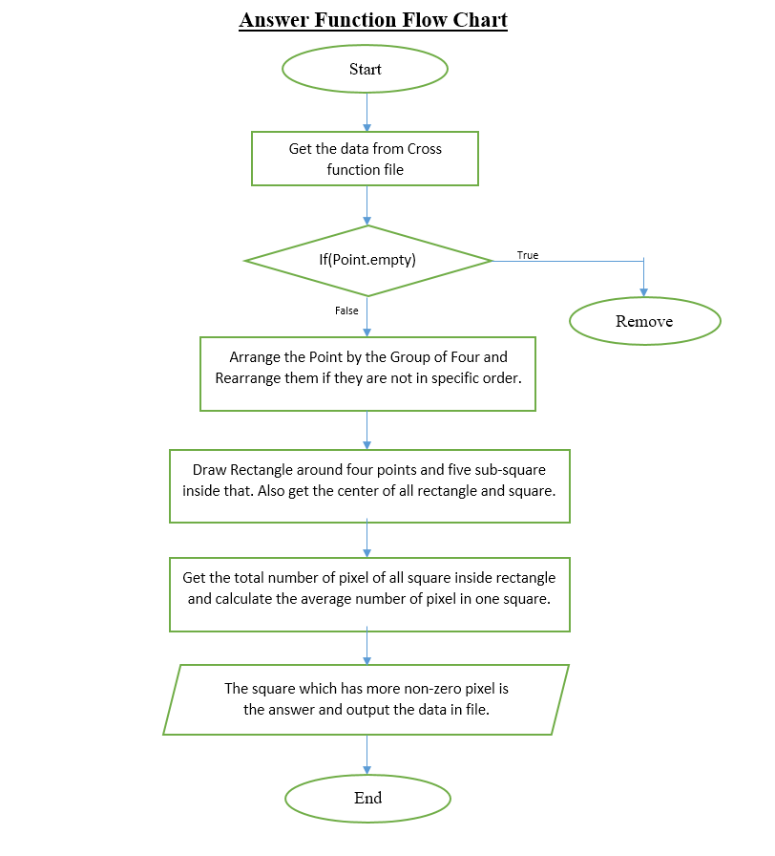
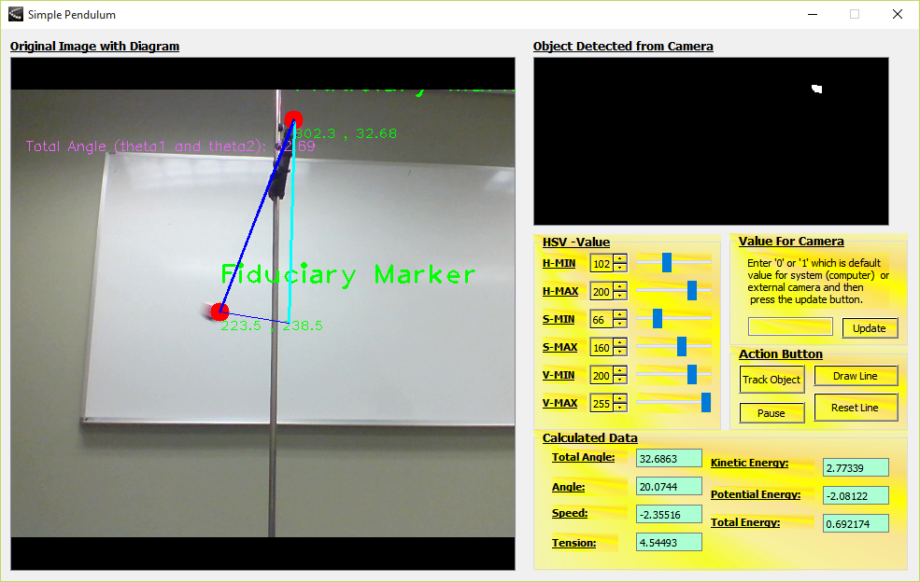
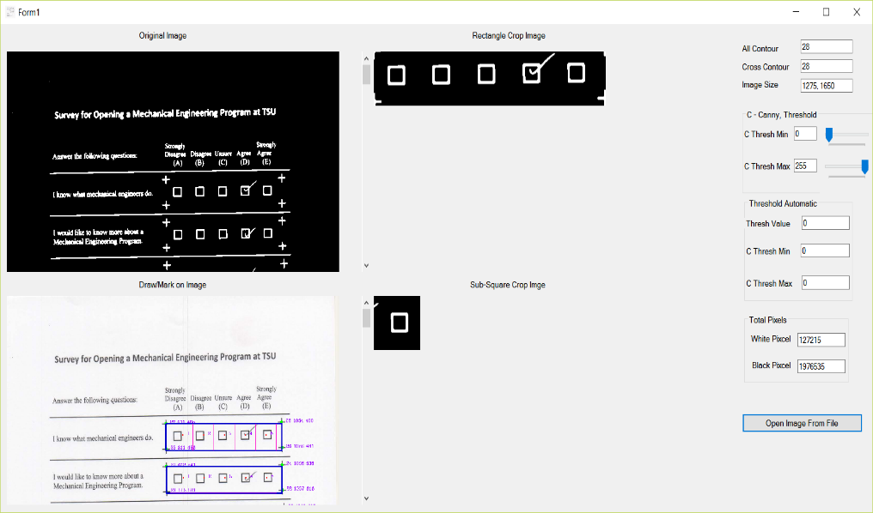
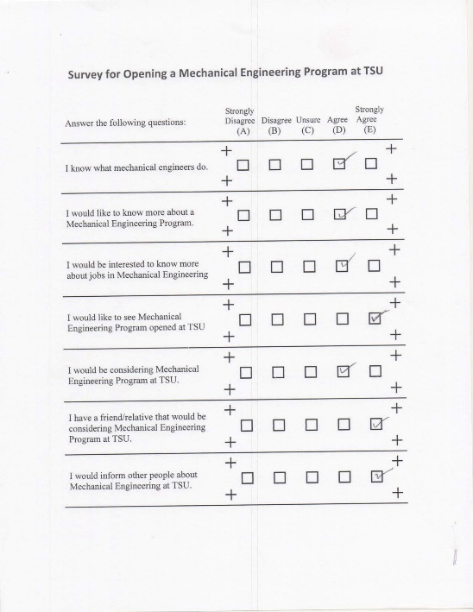
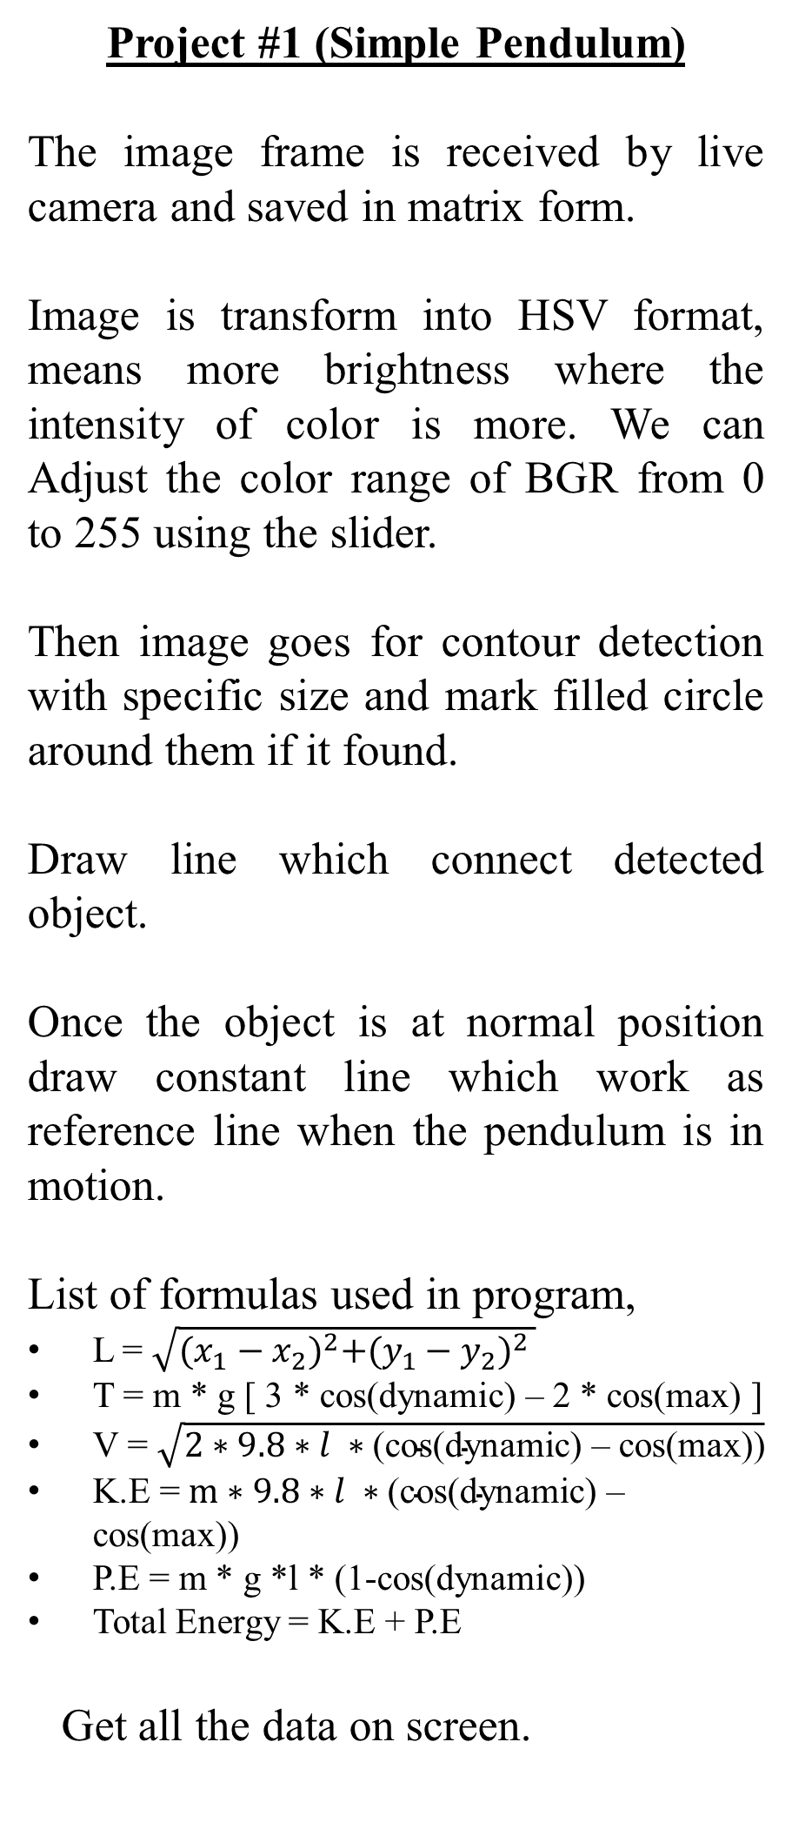
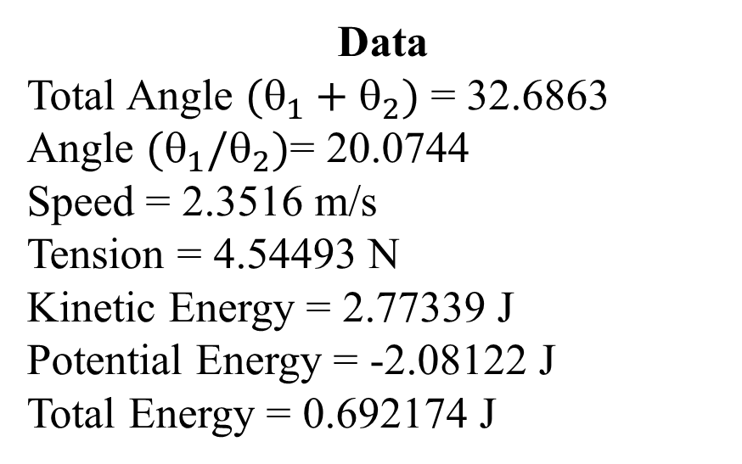
Application of Computer Vision
Anish Patel, Advisor: Dr. Daniel Vrinceanu
Department of Physics and Computer Science, Texas Southern University
Introduction
Result and Discussion
Programming Flow-Chart
The research project aims to develop computer vision application which solved real world problems. In our recent project we use high level programming language like C++ and C#. Also, computer vision library like OpenCV for C++ and EmguCV for C#. Below two applications is discuss, first which do physics experiment like simple pendulum using camera and, second grading of survey paper by opening images from computer.
Abstract concepts, like velocity or force, are used in science to explain and interpret measurements and observations. An experiment is captured by a live camera and displayed on the computer screen together with some graphical representation that is calculated on the fly based on the acquired image. Graphical objects are then placed in the scene at the corresponding positions in the captured images and then displayed on the screen superimposed on the original image.
Another application uses Optical Mark Recognition (OCR) technology which will provide institute / university to grade their survey automatically using software, rather than doing by hand and provide the desire result as a text file at default destination in their computer. The program is really robust in comparison to many applications which is available in the market which grades just if the circle is totally filled, but our application can work in any condition like if some student just tick mark, cross, half-filled bubble, and small little mark. Moreover, the main formula of this application is to detect all crosses inside page (figure 1), so we don’t worry about the text, QR code, and so forth. According to the pixel density of each square we can assume that the square which has highest number of pixel in them is the answer
Project #1 (Simple Pendulum)
Project #1 (Simple Pendulum)
Project #2 (Survey Grading)
The graph shows angles taken by application while pendulum was in motion, we took five consecutive data reading.
Project #2 (Survey Grading)
The application was test on five different kind of survey paper marked by different students contain properties 1275*1650 pixels, horizontal & vertical resolution 150 dpi with bit depth 24. Moreover, we observe that as the noise value increase the amount of contours decrease therefore the perdition of answer decreases. Additionally, we also observe that till specific value of noise from three to twenty-five (3 to 25) there is no effect on image, so we get contours and answer accurate in that range of noise.
Application Output
Methods
Project #1 (Simple Pendulum)
Project #2 (Survey Grading)
Open image from computer as .png or .jpeg format using button on application.
Original image is transform into gray-scale, which reduce the intensity of all colors and transform them into black and white.
Apply Gaussian blur, Morphology, and canny to gray image to detect cross with morph size 19 to cross function. Also, apply Morphology and binary threshold (means 0-black and 1 – white) to detect answer with morph size 3 to answer functions on gray image and save both process image in two different variable.
Contour can be found from above cross process image and mark filled circle around them.
From above contour get the moment of each detected contour (means co-ordinate position) and save it in dynamic array, which data we will used as reference and calculation in answer function file.
Get the data of dynamic array and remove the empty element and then group it all cross by four to draw the outer rectangle, after that draw five sub-square inside that.
Calculate the total number of non-zero pixel inside in all sub square and find average number of pixel in them and increase the value by 70 pixels (approx.). The place where answer is marked like filled box, check mark, or any other shape will have more white pixel then other unfilled square and that is the answer.
Data
Total Angle $(_{1}+_{2})$ = 32.6863
Angle $(_{1}/_{2})$= 20.0744
Speed = 2.3516 m/s
Tension = 4.54493 N
Kinetic Energy = 2.77339 J
Potential Energy = -2.08122 J
Total Energy = 0.692174 J
Project #1 (Simple Pendulum)
The image frame is received by live camera and saved in matrix form.
Image is transform into HSV format, means more brightness where the intensity of color is more. We can Adjust the color range of BGR from 0 to 255 using the slider.
Then image goes for contour detection with specific size and mark filled circle around them if it found.
Draw line which connect detected object.
Once the object is at normal position draw constant line which work as reference line when the pendulum is in motion.
List of formulas used in program,
L = $\sqrt{{(x_{1}−x_{2})}^{2}+{(y_{1}−y_{2})}^{2} }$
T = m * g [ 3 * cos(dynamic) – 2 * cos(max) ]
V = $\sqrt{2∗9.8∗l ∗\text{(}\text{cos}\text{(}\text{dynamic}\text{) – }\text{cos}\text{(}\text{max}\text{))}}$
K.E = $m∗9.8∗l ∗\text{(}\text{cos}\text{(}\text{dynamic}\text{) – }\text{cos}\text{(}\text{max}\text{))}$
P.E = m * g *l * (1-cos(dynamic))
Total Energy = K.E + P.E
Get all the data on screen.
Project #2 (Survey Grading)
Conclusion and Reference
Table – Number of Pixels in each Rectangle and Sub-Square
There are many more possible science experiments which can be program like collision of atom, find total number of protein inside microscopic cell, and Collecting data of patience for couples of years and predict what kind of medical prescription they need for future. Moreover, the next stage of survey application will use pdf file and transform it into image (.jpg or .png) and process each image one-by-one and save the desire result in spreadsheet and e-mail to respective person. In addition to this, automatically grading handwritten letters and words by using camera, which will reduce lots of work in the field of education, automatic address checking for post office, reading application for college – immigration office.
No of Questions | Total Pixel Inside Rectangle | Pixel Inside sub-five Squares |  |  |  |  | Average Number of Pixel in Square + 70
 |  | Square 1 | Square 2 | Square 3 | Square 4 | Square 5
 |  | A | B | C | D | E
1. | 3580 | 595 | 602 | 606 | 859 | 628 | 728
2. | 3382 | 602 | 594 | 565 | 790 | 567 | 693
3. | 3424 | 582 | 591 | 599 | 758 | 567 | 689
4. | 3496 | 572 | 570 | 574 | 568 | 872 | 701
5. | 3795 | 632 | 627 | 651 | 875 | 646 | 756
6. | 3420 | 580 | 574 | 592 | 577 | 755 | 685
7. | 3808 | 636 | 631 | 648 | 645 | 855 | 753
References and Citations:
www.opencv.org ( original reference of computer vision library and detailed information)
www.stakeoverflow.com ( discussion of error in code)
www.youtube.com ( video tutorial)
www.github.com (platform which share tutorial and precompiled code for learning purpose)

